Slide 1
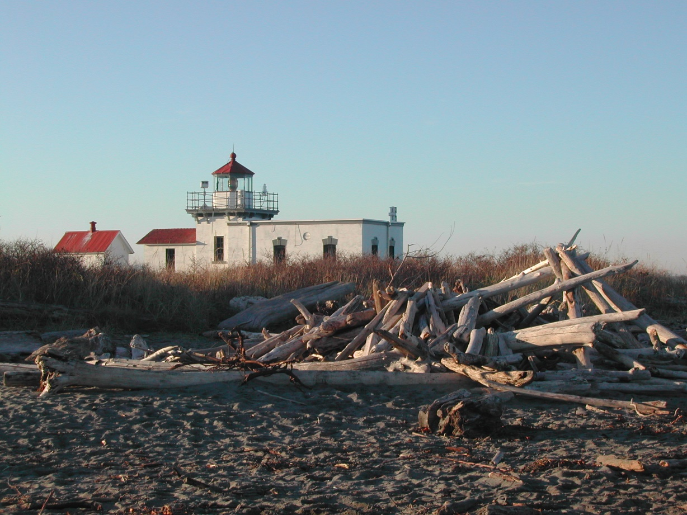
Elinor DeWire’s Quick Lighthouse Tour
Contents © Elinor DeWire 2004

Slide 2
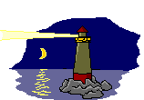
FYI
The world total of lighthouses is estimated at more than 25,000. Even landlocked nations have them on lakes and rivers.
The United States has about 680 lighthouses still standing. There were about 1500 in 1915.
Michigan has the most lighthouses in the U.S.
Washington has 21 lighthouses remaining. Cape Disappointment is the oldest, established in 1856.

Slide 3
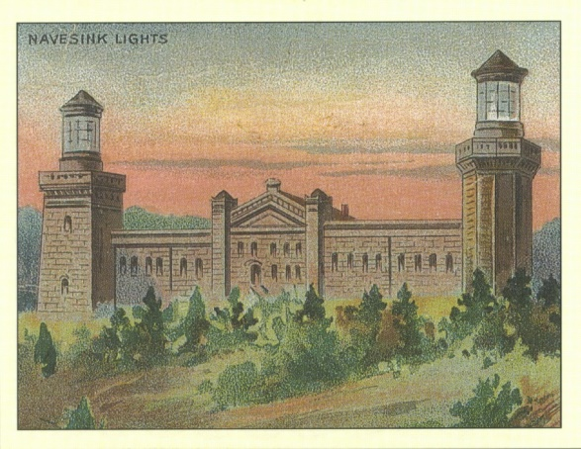
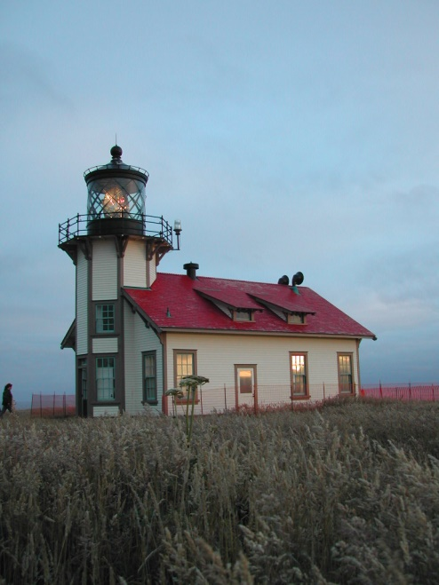
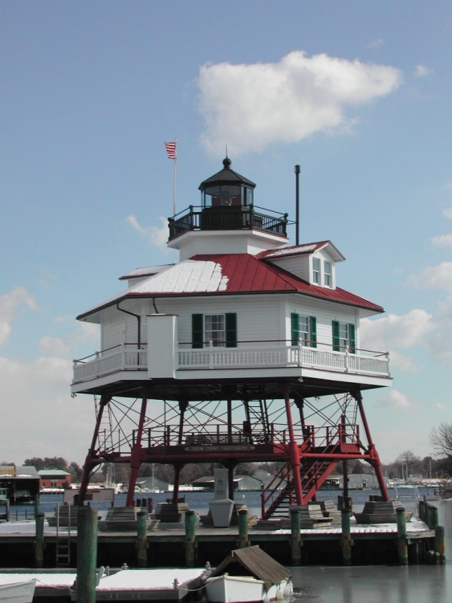
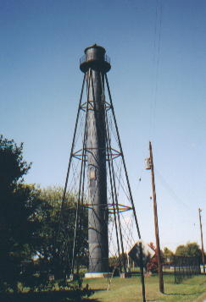
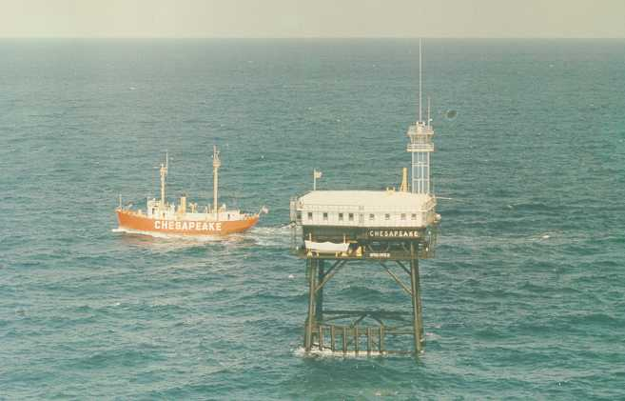
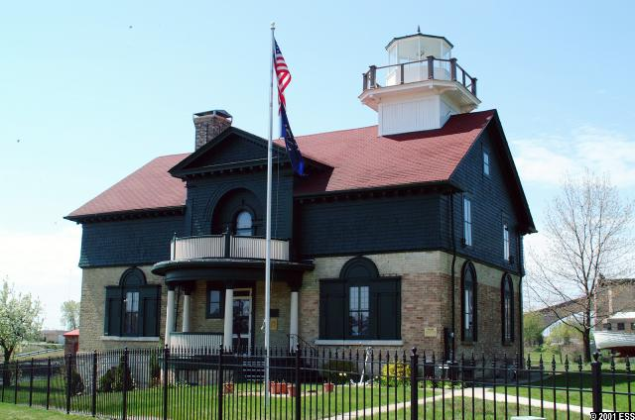
What is a “lighthouse?”

Slide 4
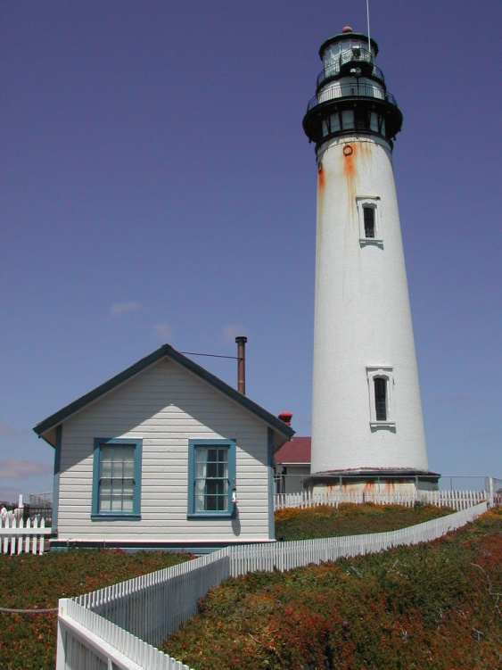
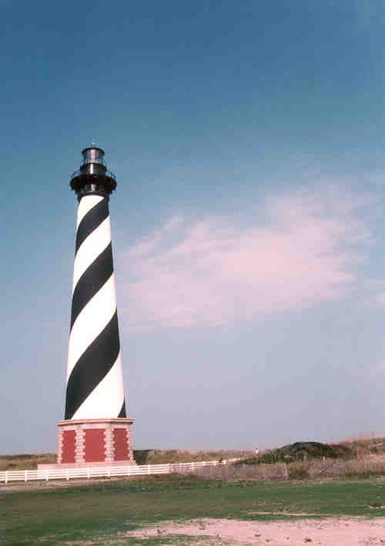
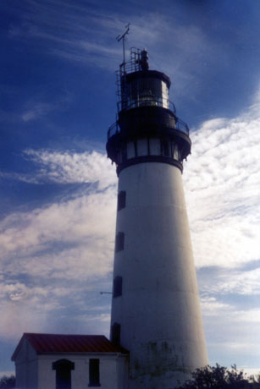
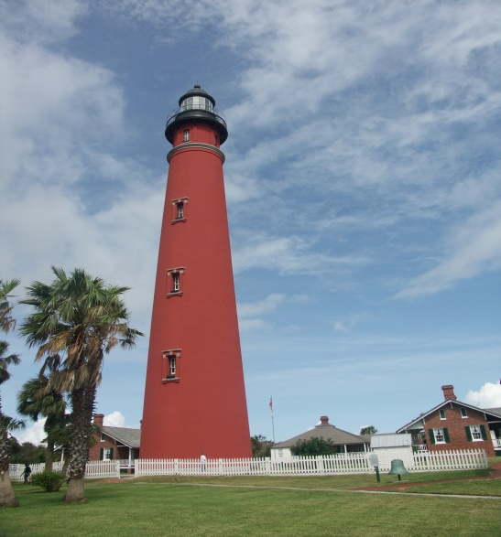
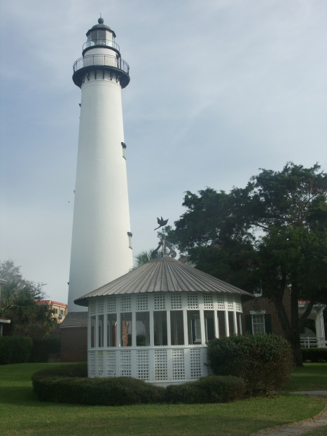
Form Follows Function
Seacoast or “landfall” lights on low beaches need to be tall.

Slide 5
Landfall lights on high cliffs need not be so tall.

Slide 6
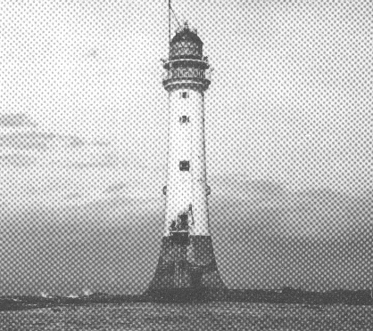
Landfall rock/reef lights that stand at sea

Slide 7
Island Lights

Slide 8
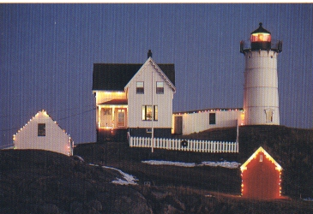
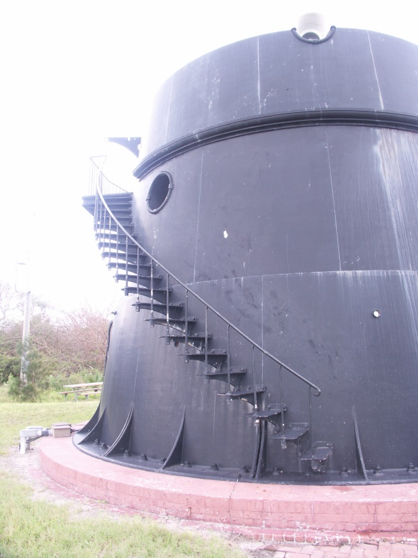
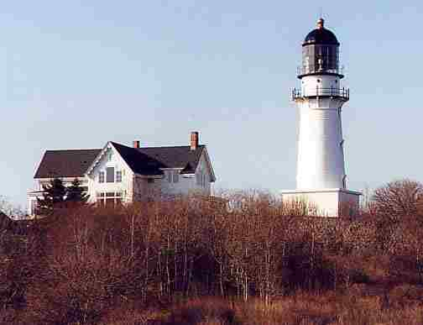
Cast Iron Collapsible Towers
They’re like Lego pieces that come apart and reassemble.

Slide 9
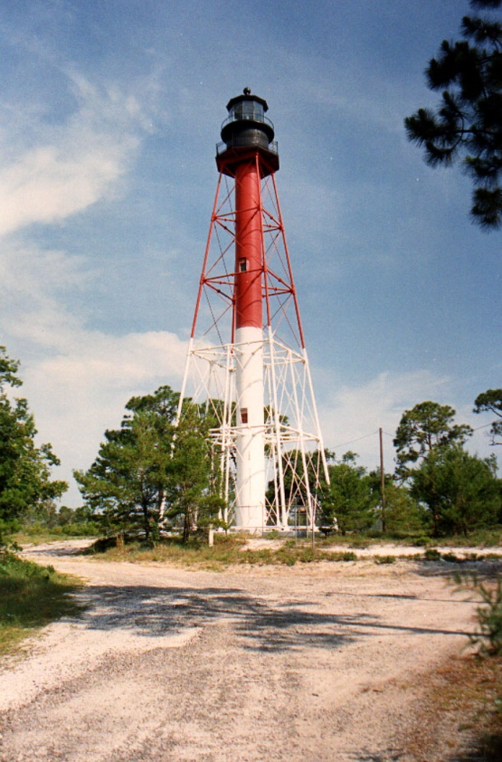
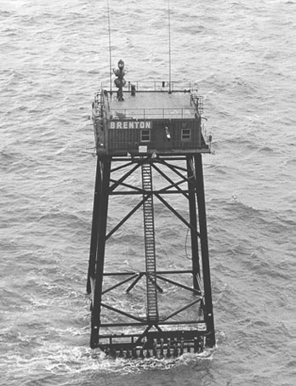
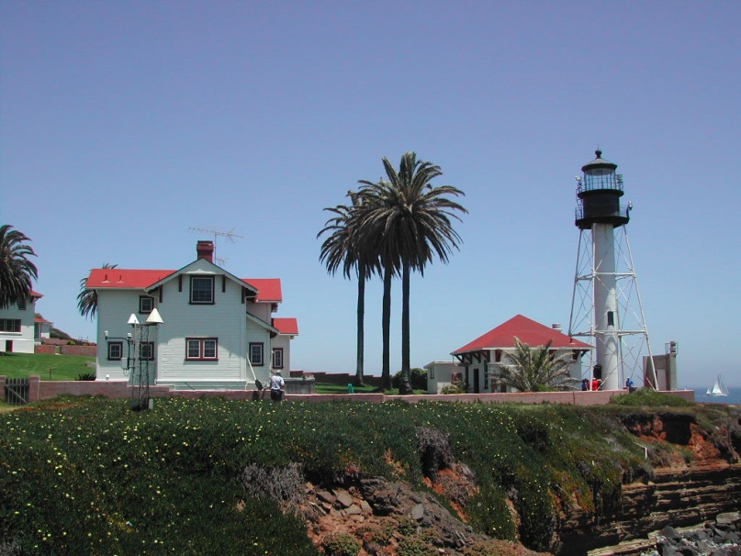
Pile, Screwpile, & Texas Tower Lights
Legs are screwed into reefs or the sea floor.

Slide 10
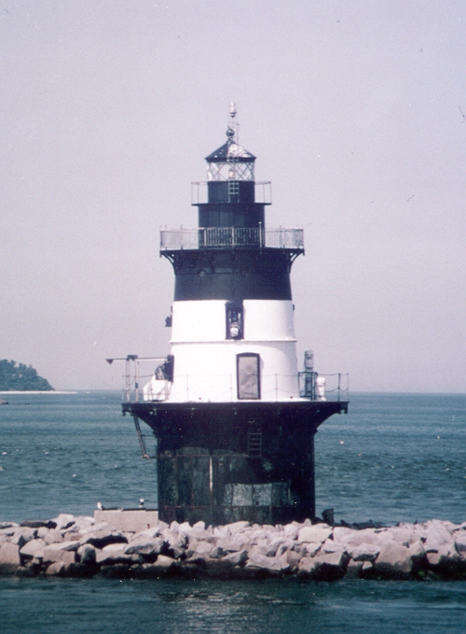
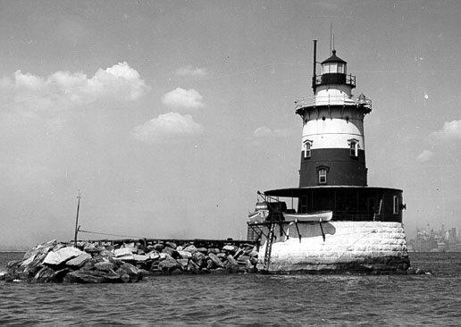
Caisson Lights
Built on piles of rocks and fabricated cribs.

Slide 11
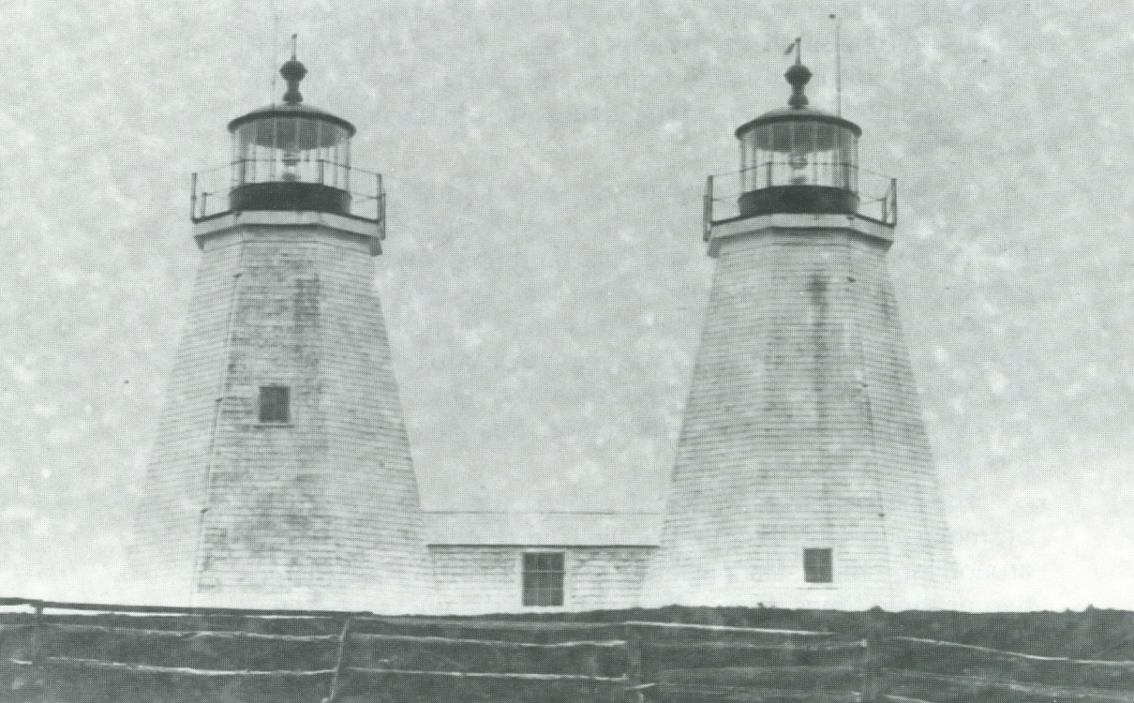
Twin Lights
These served before technology advanced to produced flashing lights. In the old days, all lights were white and did not flash to identify themselves.

Slide 12
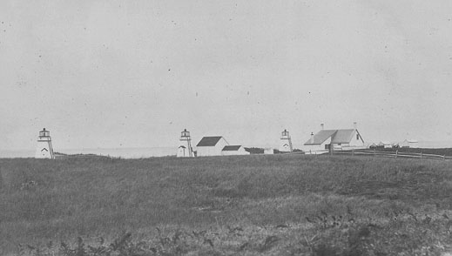
Nauset Triple Lights, Cape Cod
Only a few triple light stations were built in the world. The United States had one.

Slide 13
Buttressed Lights
A Canadian architect & builder designed these towers to provide extra stability.

Slide 14
Incorporated & Cottage-Style Lights
These com,bined the quarters and lighthouse or the lighthouse and fog signal building.

Slide 15
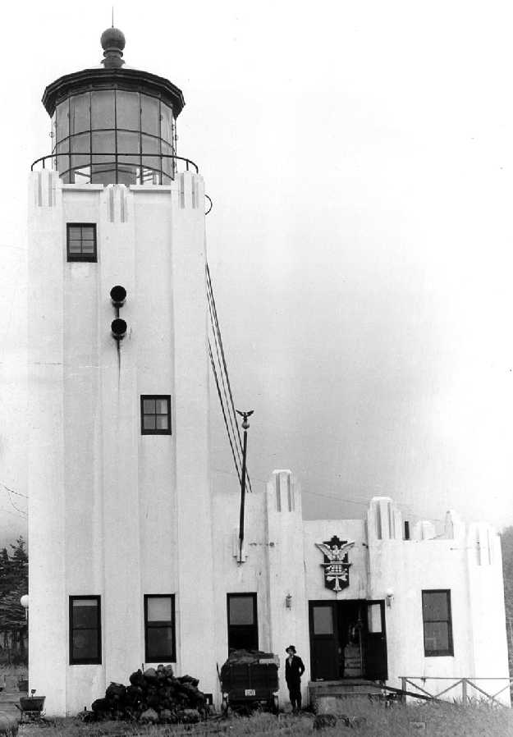
Reinforced Concrete Towers
Built after 1900 when reinforced concrete came into use. This made a strong lighthouse!

Slide 16
Art Deco & Carpenter Gothic

Slide 17
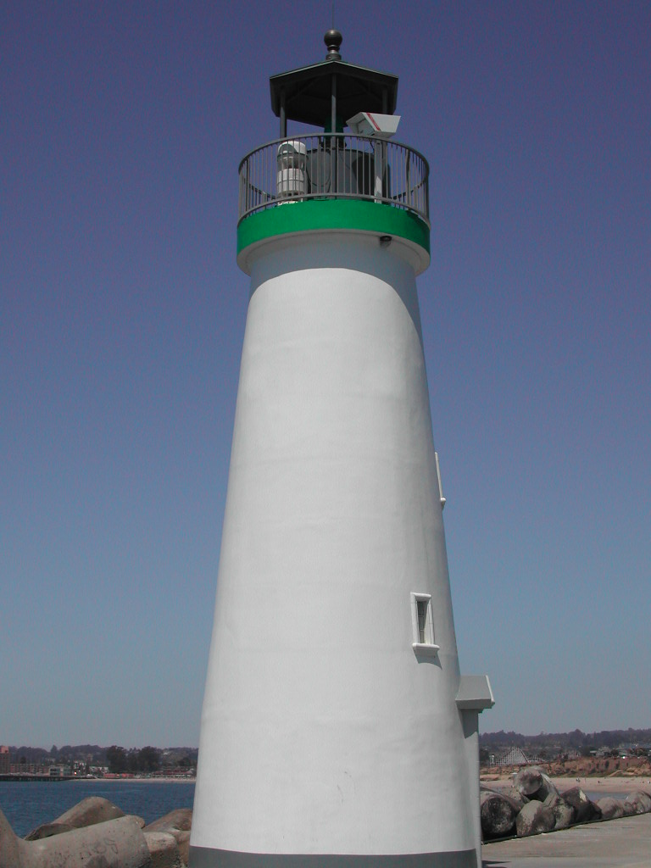
Skeleton Towers & Modern Lights

Slide 18
Superlatives Oldest
Pharos of Alexandria, Egypt – 180 B.C.E., oldest known lighthouse in the world.
La Coruna, Spain – Middle Ages
Sandy Hook, New Jersey – 1764 is the oldest lighthouse in the United States.

Slide 19
Tallest Cape Hatteras Ile de Vierge
198 feet, tallest in the USA
273 feet, in France and tallest in the world.

Slide 20
Brightest
Oak Island, North Carolina, brightest in the USA.
Cape Point, South Africa, said to be the world’s brightest.

Slide 21
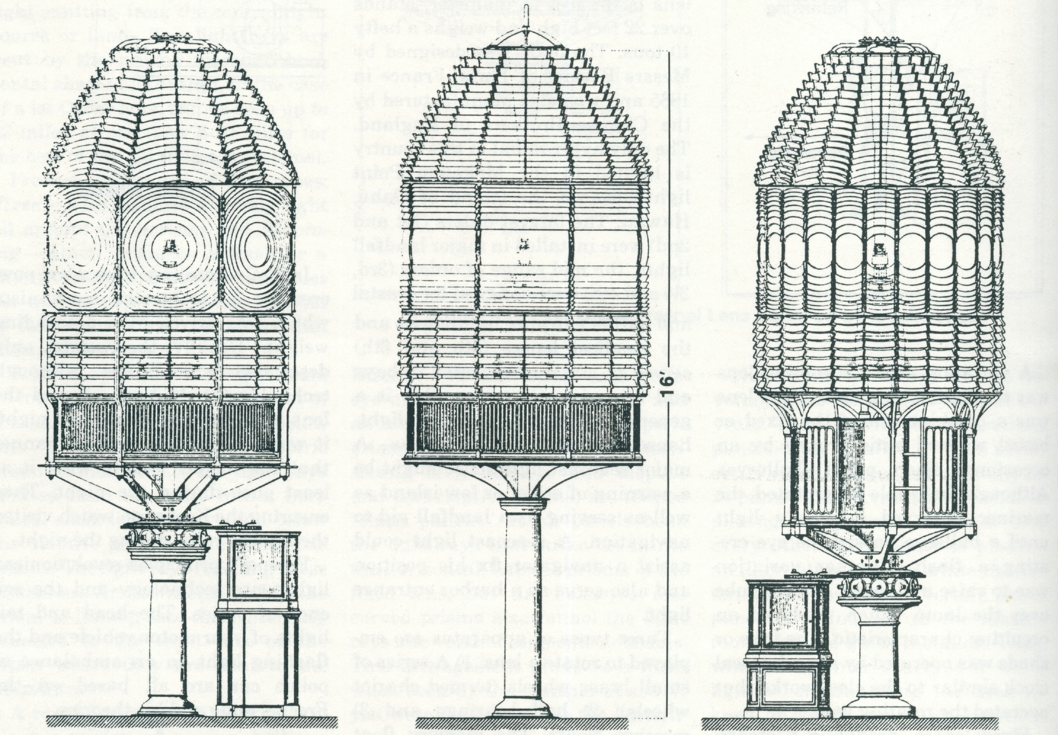
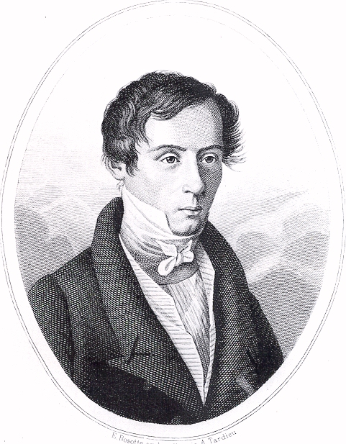
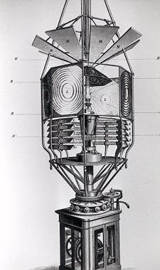
Fresnel’s Amazing Lens
Jean-Augustin Fresnel, a French physicist, revolutionized lighthouse optics in 1826.

Slide 22
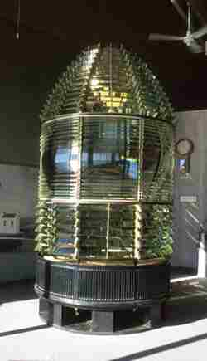
Lenticular Optics
Assateague
Cape Canaveral
Cape Disappointment
Au Sable
Destruction Island

Slide 23
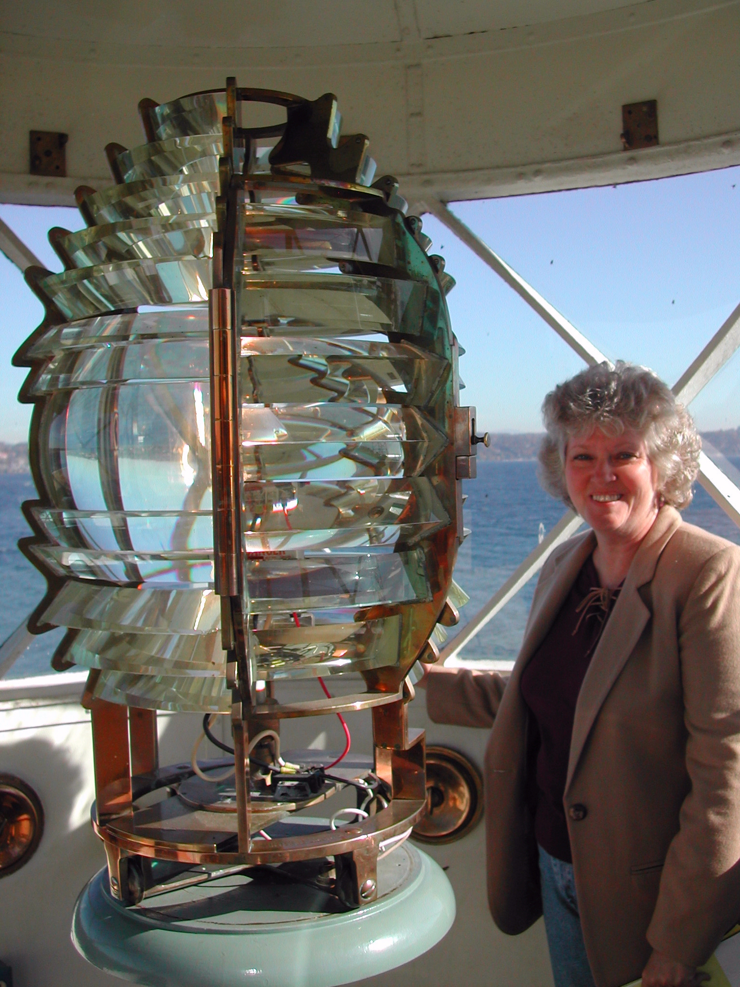
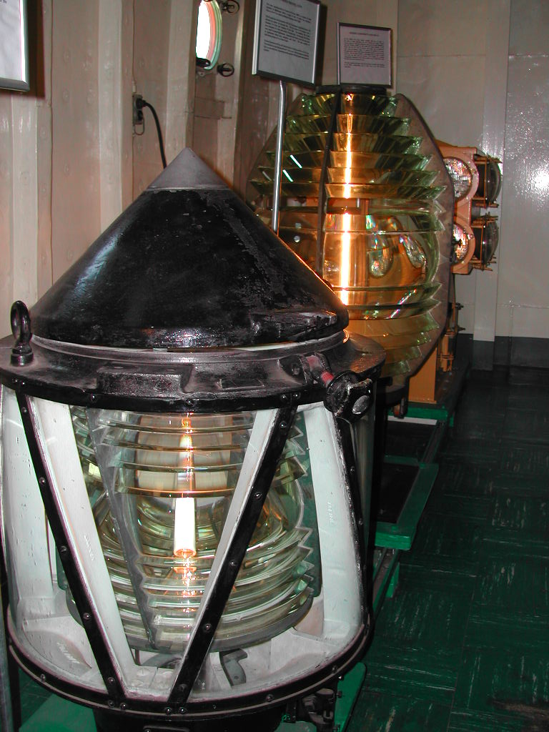
Negril drum lens
DeTour Reef 3.5
Admiralty Head
Lightship lenses
Navesink clamshell
Point Robinson

Slide 24
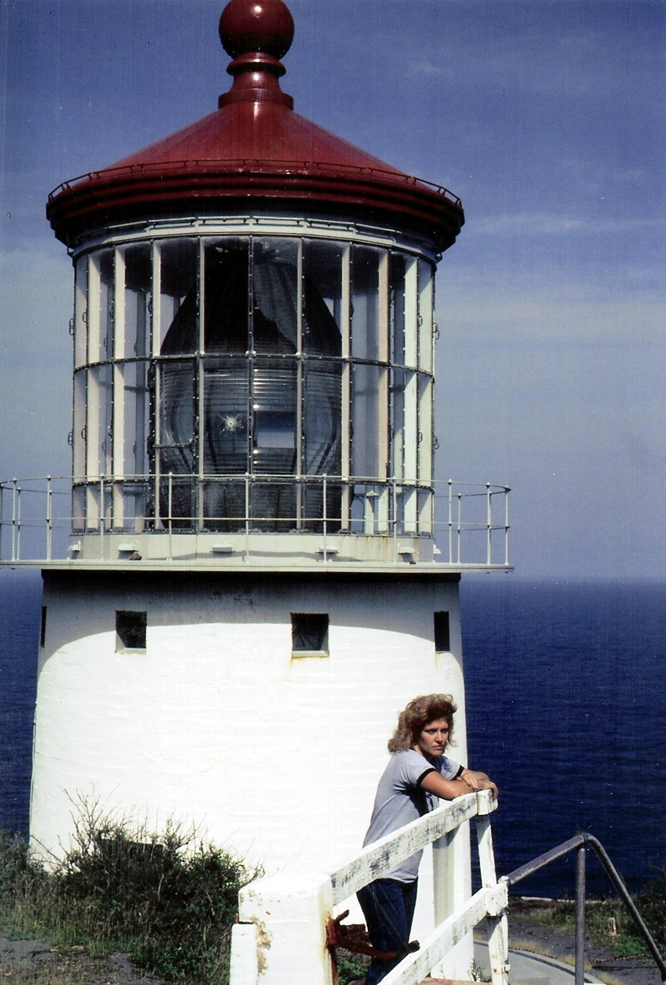
Largest Lens Hyper-Radial
Makapu’u Point, Hawai’I has the only hyper-radial lens in the United States.

Slide 25
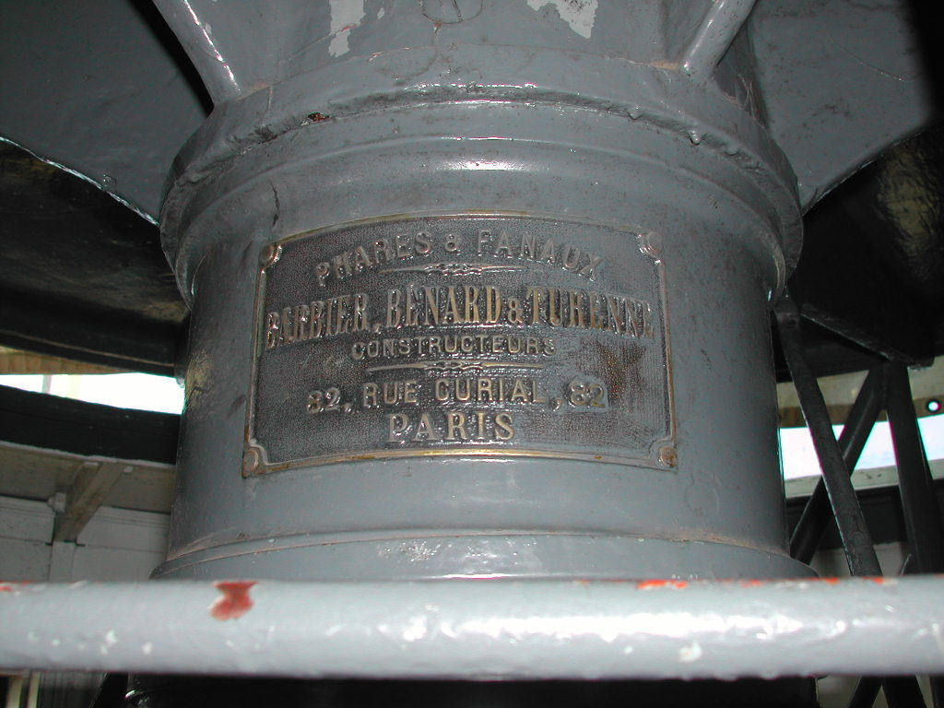
Destruction Island chariot wheels
Lens Rotation Methods
Point Reyes gear mechanism
Weight-drop cage at right—the appartus worked somewhat like a cuckoo clock with weights.
Point Reyes mercury float

Slide 26
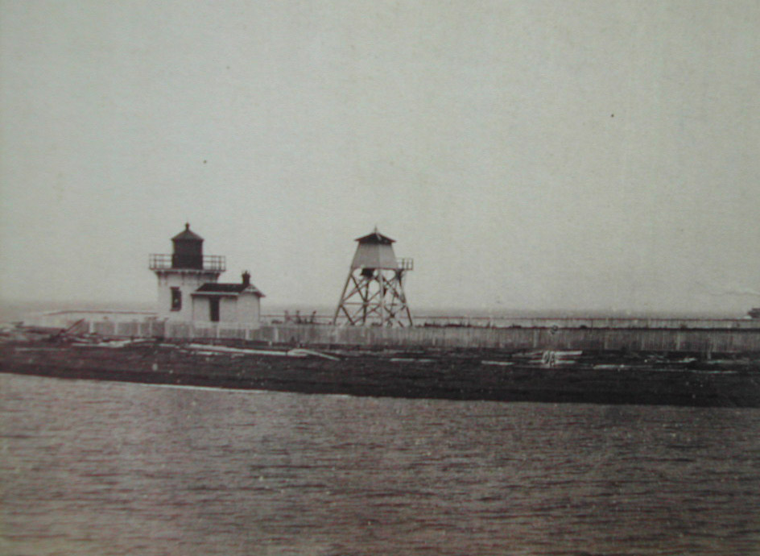
Fog Signals - Bells
Many lighthouses had fog signaling equipment.
Avery Rock
Cape Neddick
Point No Point
Browns Point

Slide 27
Steam Whistles & Sirens
Point Robinson (both images left)
The smokestacks show where the coal-fired boilers were located to make steam.
Cape Flattery

Slide 28
Compressed Air Horns
These blared the classic beeeee-ooohhhh!
Semiahmoo
Turn Point

Slide 29
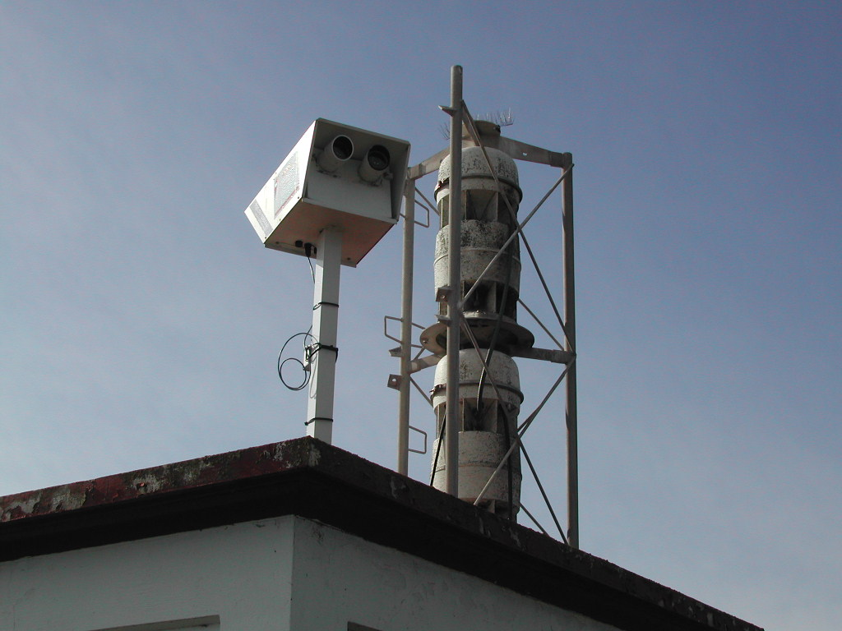
Modern Lights & Horns
Modern Fesnel lens
Point Reyes
Point Sur
Light sensors below look like eyes and turn the lights on and off or turn the fog signals on and off.
New Dungeness
Point No Point

Slide 30
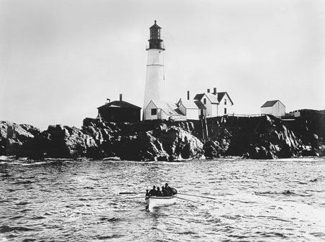
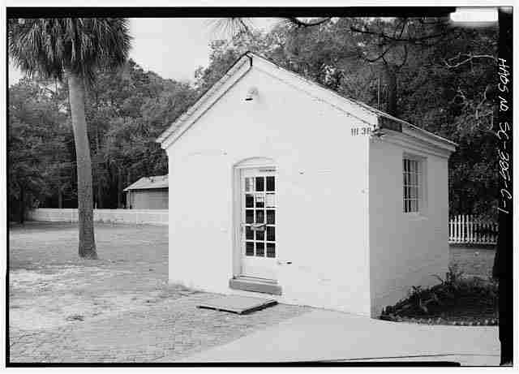
Fuel Storage
Cape Canaveral
Cape Neddick
New Dungeness
Portland Head
Point Vicente
Hunting Island

Slide 31
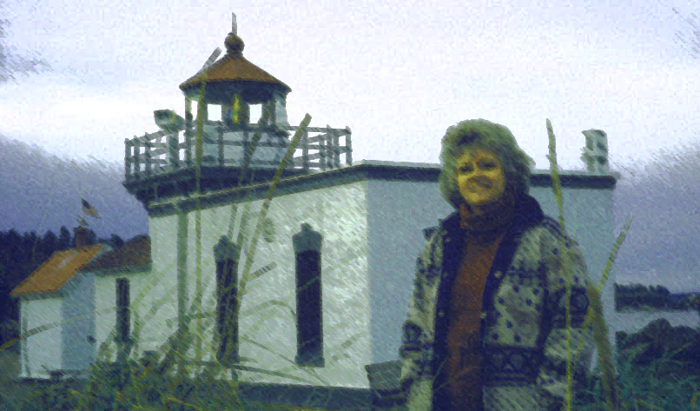
Thanks for viewing!
Check out my Lighthouse Blog at elinordewire.blogspot.com.
Visit my Author Facebook Page at “Elinor DeWire, Author.”
Send me email at Elinor@uslhs.org

