Slide 1
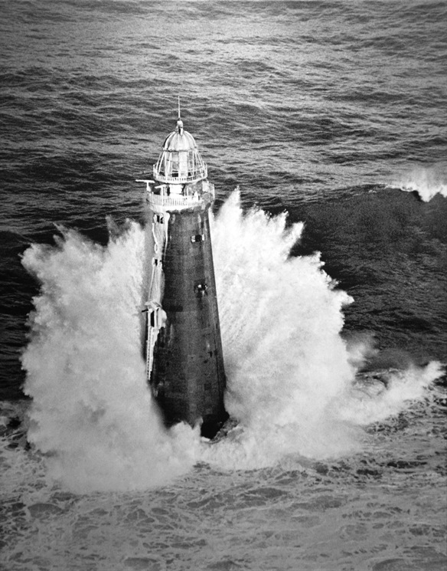
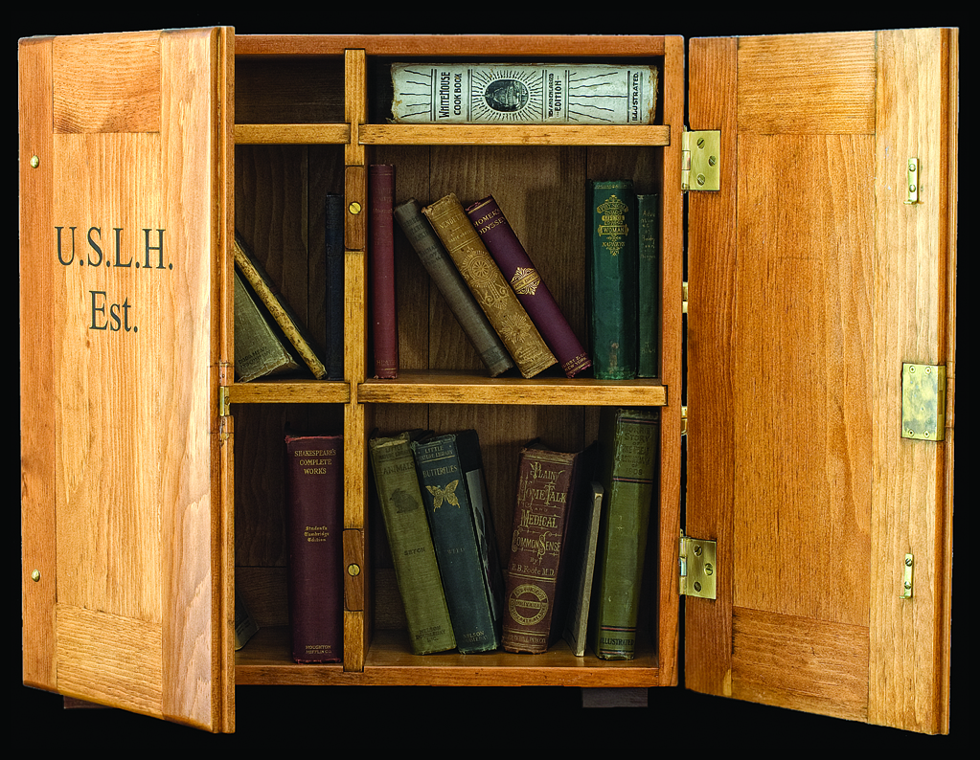
The Lighthouse Keeper’s Library

Slide 2
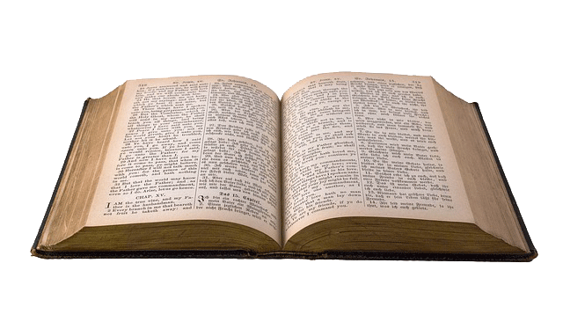
Lightkeepers had Free Time
Lighthouse keepers had plenty of work to do—caring for the light and the tower and sometimes the fog signal too, keeping the grounds groomed, painting, cleaning, repairing, and more. There usually wasn’t a lot of free time. But when there was free time…

Slide 3
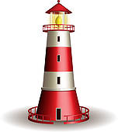
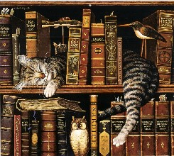
Lighthouse Keepers Loved to Read!
Some lightkeepers had large personal libraries…and a cat to keep them company. When their work was done, they enjoyed reading. It was a way to learn and be entertained.

Slide 4
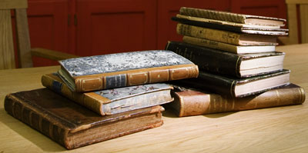
But…Books were Expensive
…and lightkeepers did not make much money. In the 1870s the average principle lightkeeper made only $500-$600 per year. A book was a special purchase! Most lighthouse keepers did not have money to buy books of their own.

Slide 5
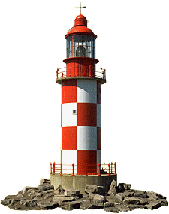
Seaman’s Friend Society
The Seaman’s Friend Society of Boston, Massachusetts provided free books and other reading materials for sailors on ships.
The Lighthouse Board, which formed in 1851, thought free books might benefit lighthouse keepers too.

Slide 6
Arnold Burgess’ Great Idea
Arnold Burgess was the Lighthouse Board’s Chief Clerk. He managed money. He knew there was always leftover money from projects…but he wondered how best to use it? Why not reward the keepers for their excellent work and dedication? Why not give them free books to read?

Slide 7
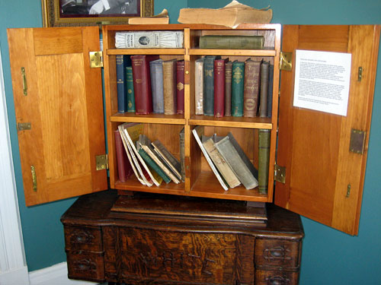
Portable Libraries for Lighthouses &Lightships
Burgess used the extra money to build small libraries that could be moved from lighthouse to lighthouse.
Oak for strength
Shiny brass fittings
A closeable case
A nice piece of furniture
The first libraries were loaned to lighthouses in 1876.

Slide 8
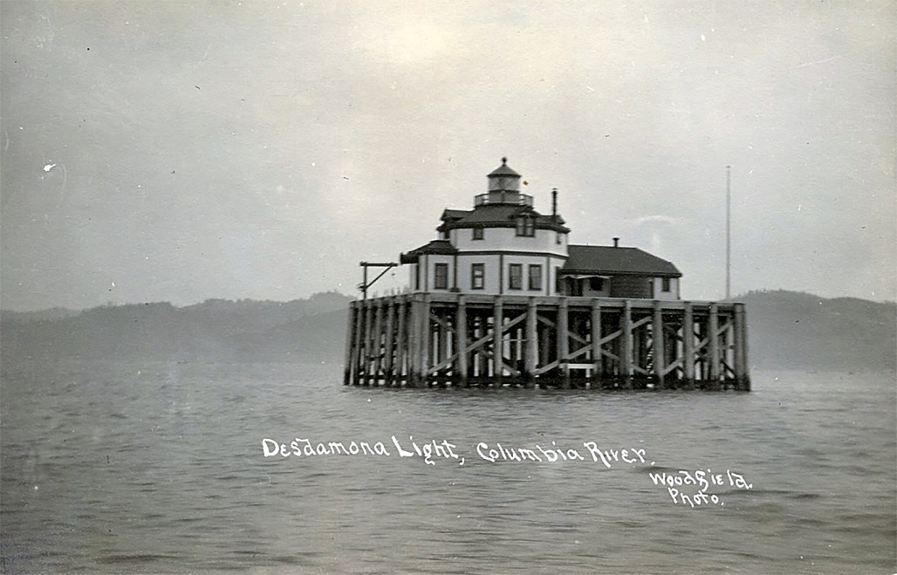
The Books in the Lighthouse Library
Popular Novels
How-to Books
Cookbooks
History & Geography
Poetry
Classic Literature
Housekeeping
The Holy Bible
A Prayer Book
There were about 50 books in all. Many were donated by publishers or bought at a discount.

Slide 9
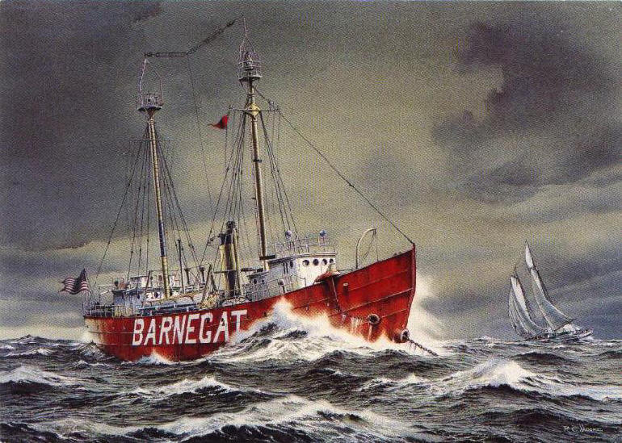
The Rules & Regulations
Handle books with care.
Sign out books on a card.
Return books on time.
Request specific topics or titles.
The library will be inspected before being transferred to another lighthouse.
A ruined or lost book must be paid for and replaced.
Old, tattered books will be given to deserving keepers as gifts.
Burgess required lighthouse keepers to follow traditional library rules.

Slide 10
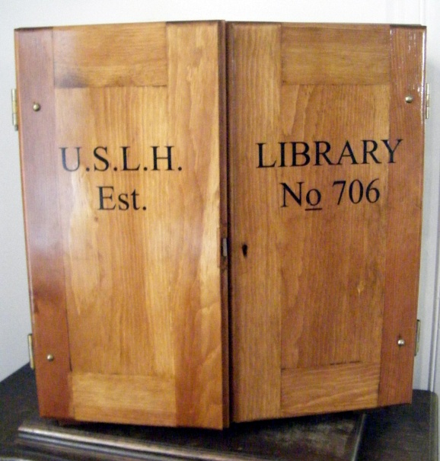
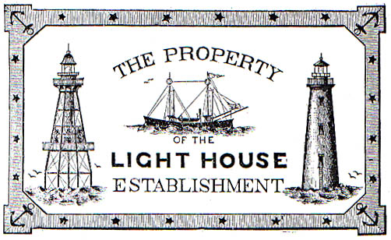
Details
Inside each book was the U.S. Lighthouse Establishment Bookplate
Each library was numbered.

Slide 11
Records were kept
This was the sign-out sheet.

Slide 12
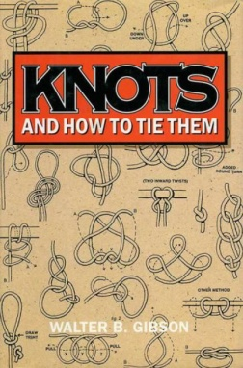
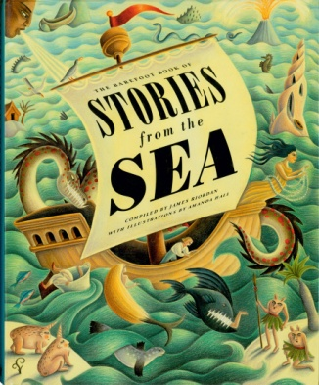
Make a Classroom Lighthouse Library!
Use a sturdy cardboard box. Have students paint it brown and write U.S.L.H. Est. on one flap (door) and Library No.__ on the other flap. (Use your classroom #.)
Have a discussion about what kinds of books a lighthouse keeper would enjoy reading. In small groups, ask students to make a list of topics. Share results.
Then, visit the school library and have each student choose a book.
Back in class, ask each student to show his or her book and explain how it would interest a lighthouse keeper.
Fill the Lighthouse Library! Use a system to organize the books.
Create a checkout sheet and assign book reviews.

Slide 13
Guided Discovery Interpretation
What was the nature of lightkeeping long ago that there would be time to read, or a need to read?
What novels and nonfiction books were available in 1876 when the libraries began circulating?
If light keepers wanted to repair something or learn a new hobby, could they learn about it from a book?
Why did light keepers like cookbooks?
Mark Twain’s books weren’t included in the USLHE libraries? Can you guess why?
If there were light keepers today, what/how would they read?
Internet, Audio Books, eBooks, and more! How far we’ve come since the days of the portable lighthouse libraries! Compare and contrast the Lighthouse Portable Library with today’s high-tech library.

Slide 14
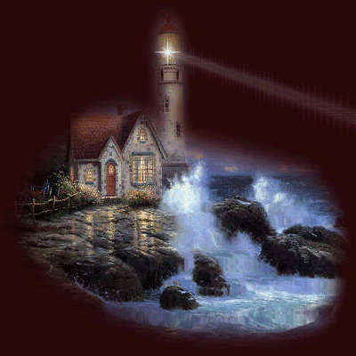
Share
With other classes
At a PTO meeting
At a Book Fair
In the school library as a display
In the town library as a display
In the mall as a display

Slide 15
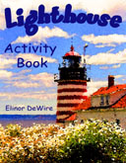
Launch a Reading Program
Starting collecting a stash of kids’ books with a lighthouse theme, or any theme, and use the replica library to start a reading program.

Slide 16
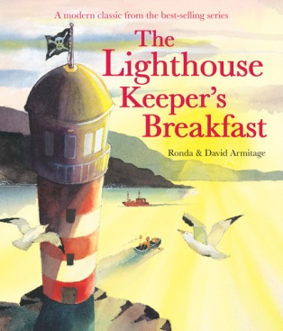
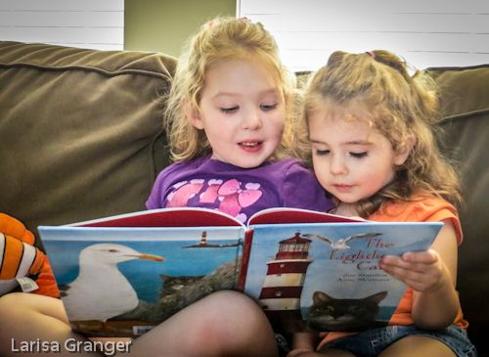
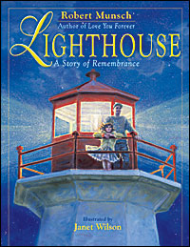
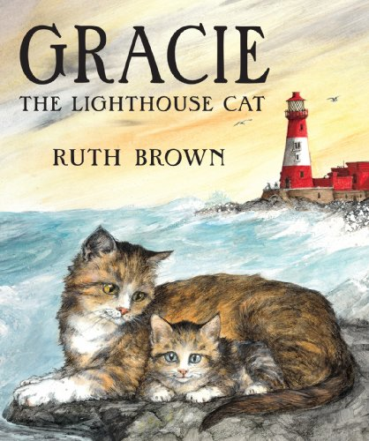
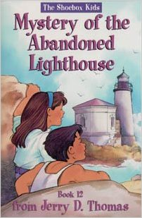
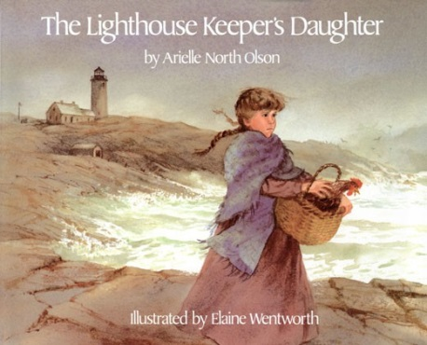
Celebrate National Library Day and National Library Week with a reading event and the portable lighthouse library.
Create a reading initiative. Motto:
“Read like you’re a lighthouse keeper!”

Slide 17
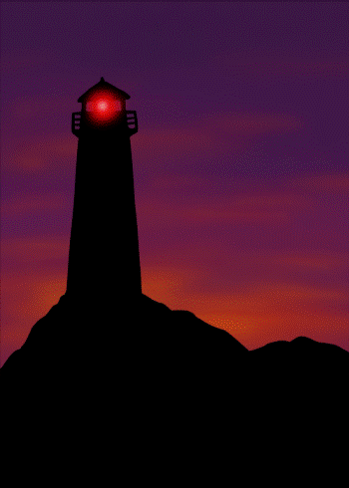
“Nothing moves the imagination like a lighthouse!”
Samuel Adams Drake
And a good book too!

Slide 18
United States Lighthouse Society
Elinor DeWire, Education Chair

